Slide 1
ANF Reference Model

Slide 2
ANF Reference Model Overview
Condition
Medication Request
Vital Signs Observation
Analysis Normal Form

Slide 3
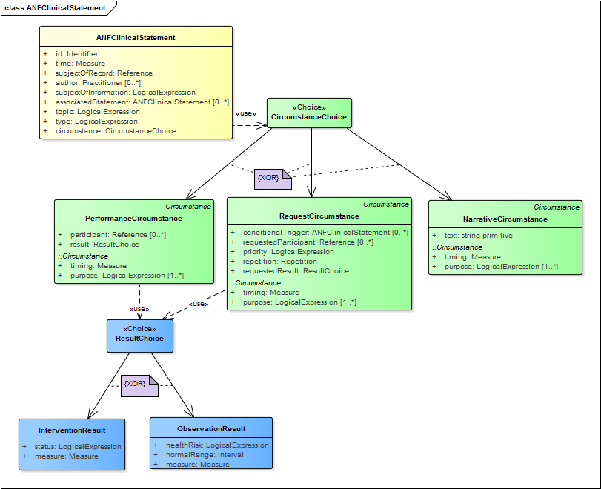
ANF Clinical Statement
“circumstance” choice
Exclusive OR
Base class
“result” choice
Inherited attributes
Exclusive OR
Encapsulated “measure”

Slide 4
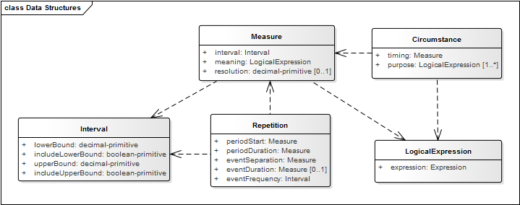
ANF Building Blocks

Slide 5
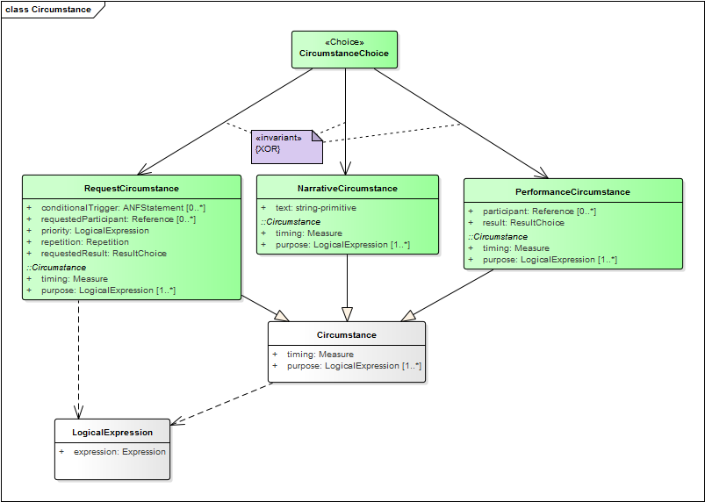
ANF Polymorphic Structures: Circumstance

Slide 6
ANF Polymorphic Structures: Result

Slide 7
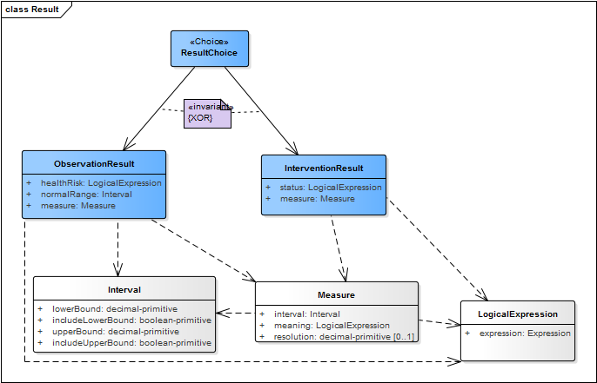
Example: Order Vital Signs Exam

Slide 8
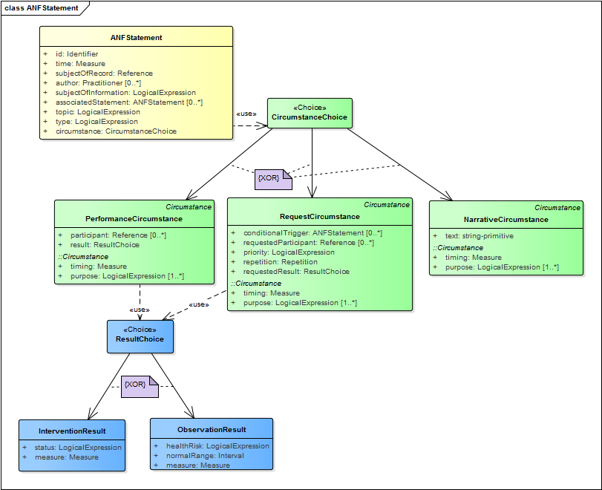
Example: Order vital signs exam
Statement → Request → Observation Result

Slide 9
Example: Vital signs exam completed
Statement → Performance → Intervention Result

Slide 10
Example: Vital signs result completed
Systolic blood pressure:
Statement → Performance → Observation Result

Slide 11
Example: Discharge medications ordered
Statement → Request → Intervention Result

Slide 12
Example: Medications administered
Statement → Performance → Intervention Result

Slide 13
Example: Dialysis completed
Statement → Performance → Intervention Result

